Slide 1

Web Development 1
Software Technology Engineering - 1. Semester
VIA University College

Slide 2
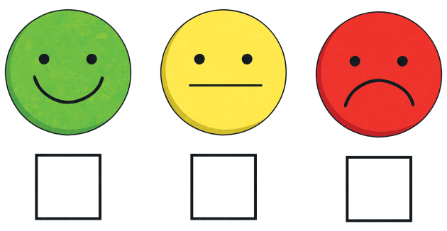
Midterm evaluation
Please fill in the midterm evaluation on itslearning

Slide 3
Working on Assignment 2
The second out of three assignments that are part of your exam in WEB1
This assignment is a group assignment
If you want feedback, then submit before the deadline!
Assignment 2
  You have 4 hours today
  Two weeks to complete the assignment
Make sure to ask a lot of questions today

Slide 4

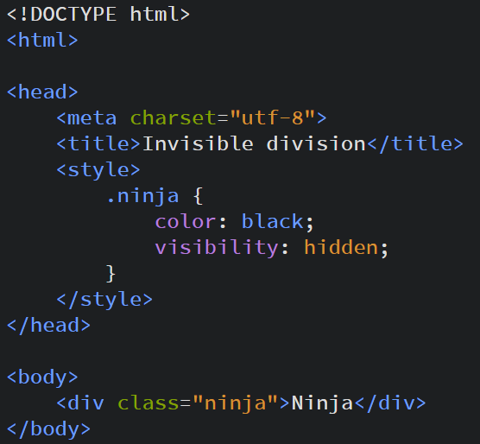
The rules
Only HTML and CSS!
Don’t just download something cool
Understand what you do
No frameworks
No in-line styling allowed

Slide 5

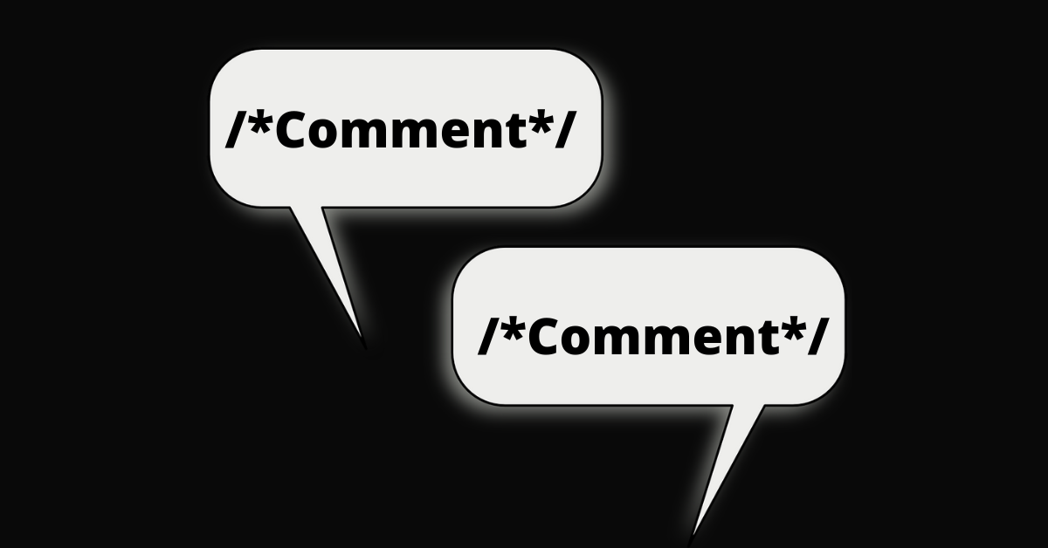
Remember…

Slide 6
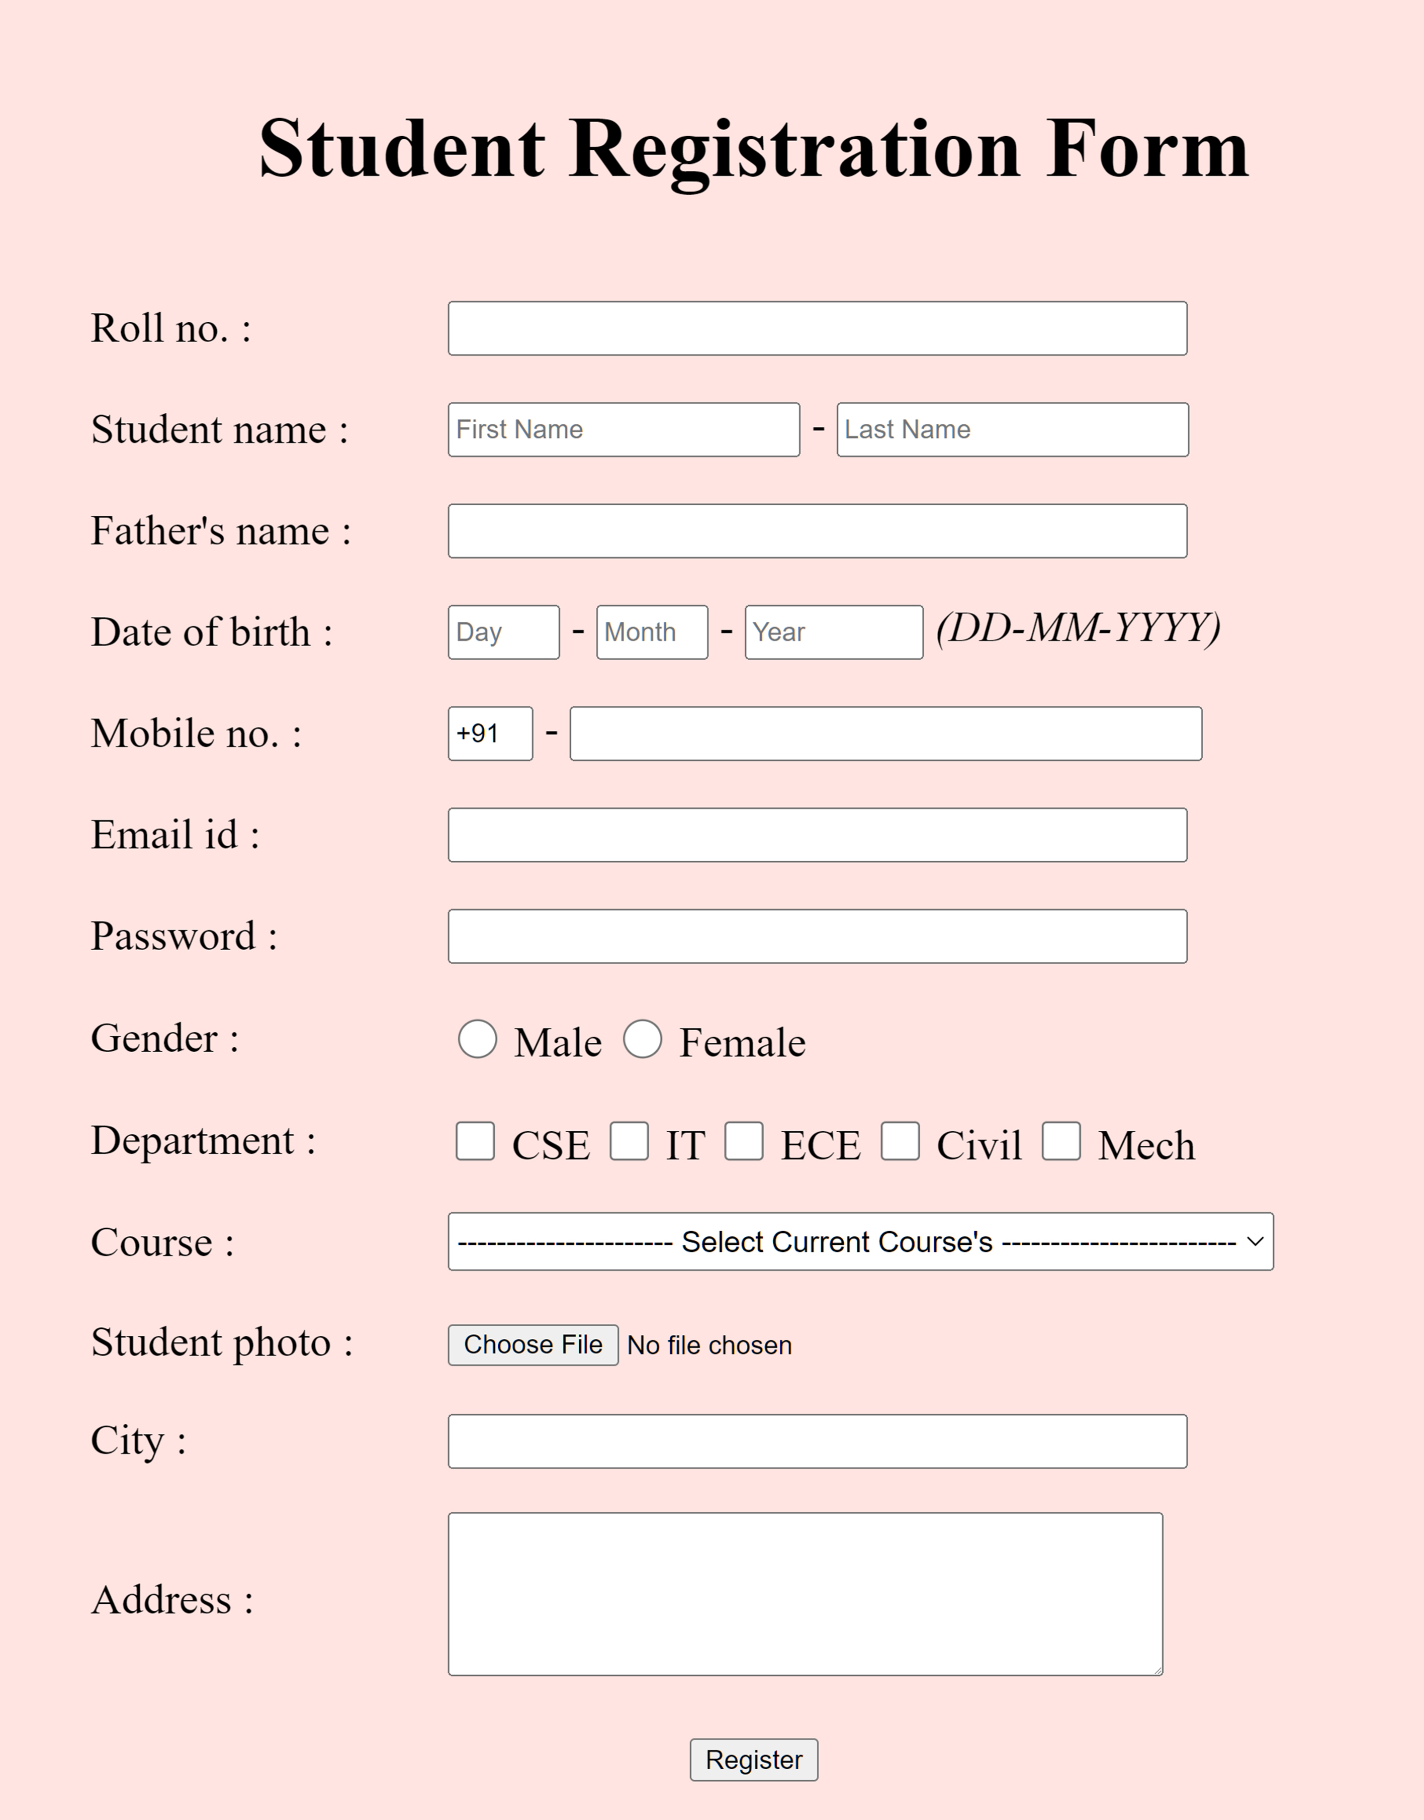
The webpage
A web form for creating a user account
variety of personal and preference-related data
Usability, accessibility, and responsive design

Slide 7

Minimum requirements
Check PDF to make sure you meet all the minimum requirements regarding content and functionality of your webpage

Slide 8
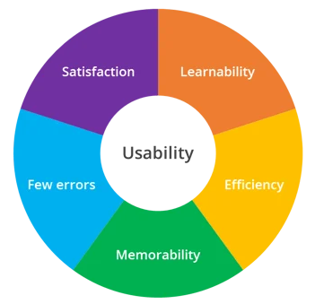
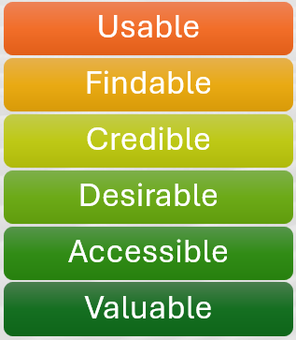
10 usability heuristics for user interface design
Remember the definition and principles for usability and the factors that affect UX
10 usability heuristics:
https://www.nngroup.com/articles/ten-usability-heuristics/

Slide 9
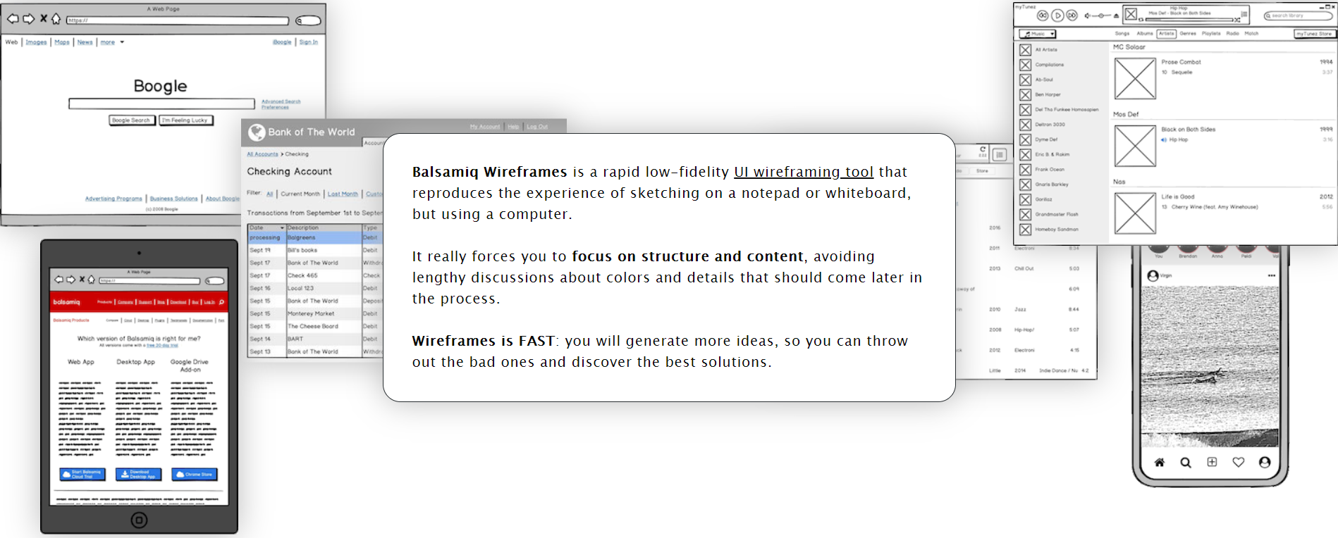
Think before you code
https://balsamiq.com/
We have a temporary license

Slide 10

<p id="fun"> Have fun &#9786; </p>
Programmers while coding
It doesn’t work…why?
It works…why?

